Slide 1

SRM INSTITUTE OF SCIENCE AND TECHNOLOGY
RAMAPURAM, CHENNAI – 600 089
FACULTY OF SCIENCE & HUMANITIES
(2023-2025 BATCH)
MINI PROJECT REVIEW II
ANUBHAV LAL
RA2332241020061
MCA-B

Slide 2
Automated Classroom Attendance System Using Face Recognition

Slide 3
topics
Abstract
Introduction
Modules Description
Diagrams
Database Design

Slide 4
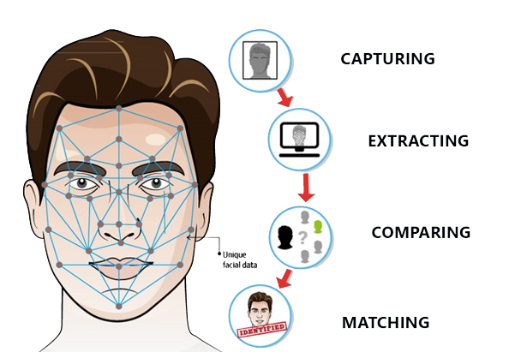
Abstract
Developed a real-time attendance system using face recognition technology.
Utilized OpenCV's Haar Cascade Classifier for accurate face detection.
Implemented LBPH for high-accuracy face recognition of students.
Enabled real-time attendance marking for up to 50 students per session.
Integrated a user-friendly Tkinter GUI for subject selection and monitoring.

Slide 5
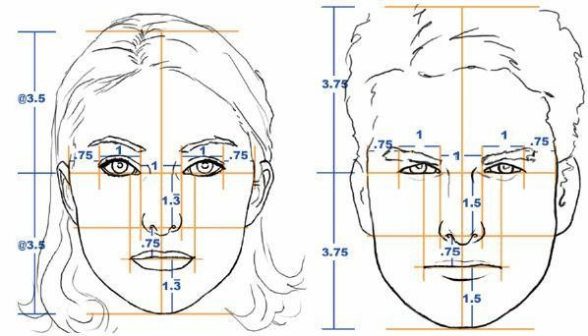
INTRODUCTION
The project addresses the need for efficient and automated attendance tracking in educational institutions.
Utilizes face recognition technology to eliminate manual attendance processes.
Combines OpenCV and Python for real-time face detection and recognition.
Aims to enhance accuracy, speed, and reliability in attendance management.
Provides a scalable solution suitable for classrooms of varying sizes.

Slide 6
Modules
Functionalities
Face Detection Module: Utilizes OpenCV's Haar Cascade Classifier to detect faces in real-time with high accuracy.
Face Recognition Module: Employs the LBPH algorithm to recognize and match detected faces with pre-registered student images.
Attendance Marking Module: Automates the attendance process, marking students present based on successful face recognition.
Data Handling Module: Uses Pandas to manage and update a CSV database containing student records and attendance data.
User Interface Module: Developed with Tkinter, providing a user-friendly interface for subject selection, attendance monitoring, and data visuaization.

Slide 7
Visual Aids

Slide 8
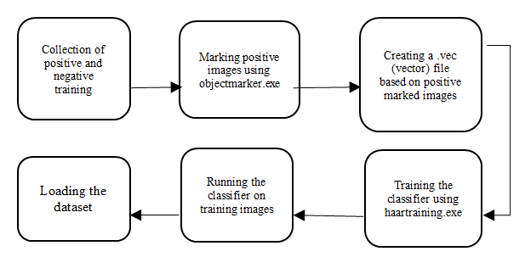
Block Diagram: The Training Process In Haar Cascade

Slide 9
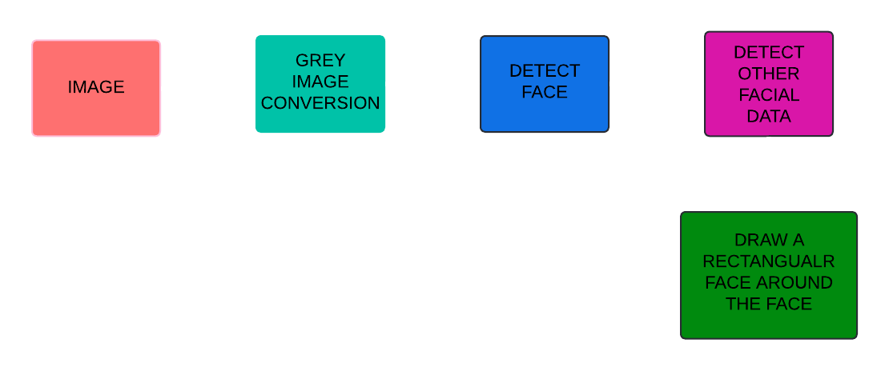
Haar Cascade Classifier workflow

Slide 10
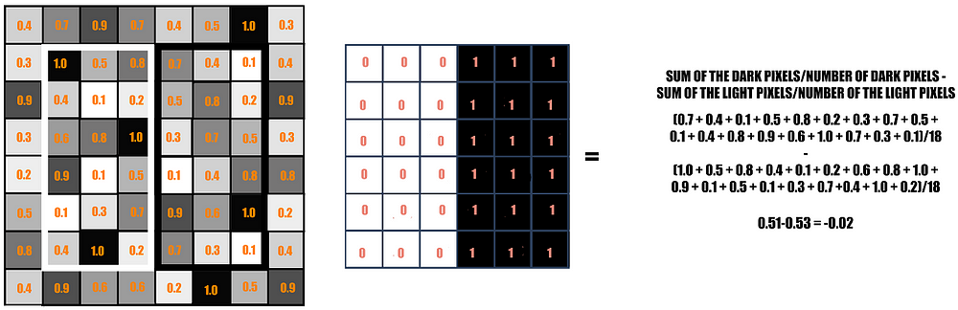
The rectangle on the left is a sample representation of an image with pixel values 0.0 to 1.0. The rectangle at the center is a haar kernel which has all the light pixels on the left and all the dark pixels on the right. The haar calculation is done by finding out the difference of the average of the pixel values at the darker region and the average of the pixel values at the lighter region. If the difference is close to 1, then there is an edge detected by the haar feature.

Slide 11
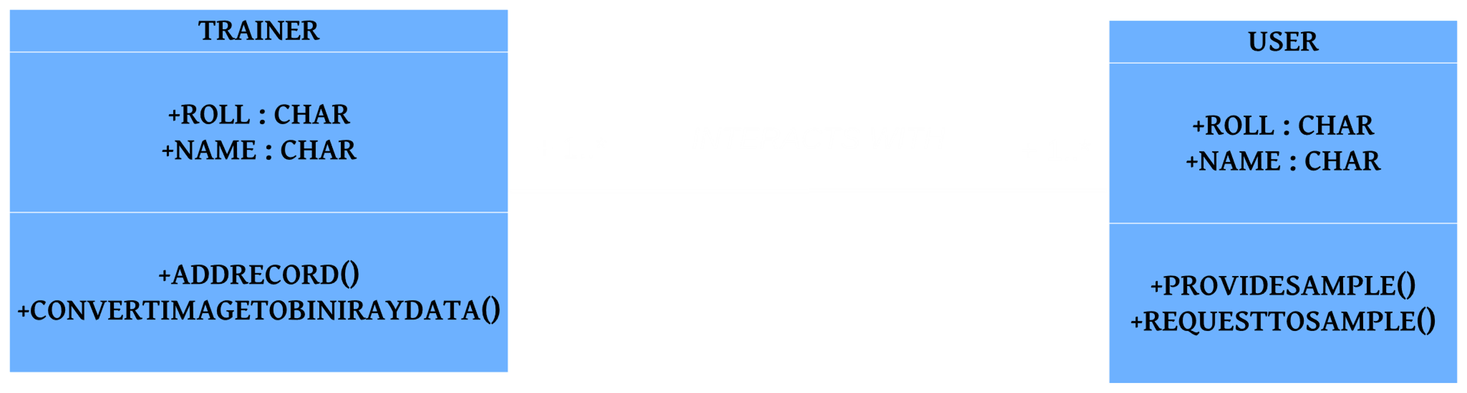
UML DIAGRAM

Slide 12
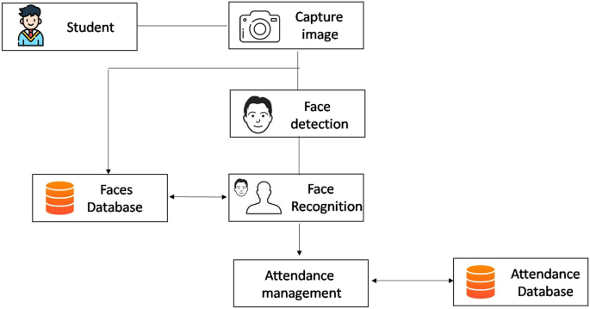
Block Diagram: Automatic Attendance System Based

Slide 13
THANK YOU
- Anubhav Lal

